Slide 1
Sea Beach view from Hotel
PRESENTED BY
NAME | ID
MIRZA MD TAWHID | 20-42643-1
MD MEHRUB KHAN LIMON | 20-42411-1
GOUROV SAHA | 20-42977-1

Slide 2
PROPOSAL
A view or scene of a sea beach will be represented by graphical drawing algorithms. This is a mini project in computer graphics which is simple, good looking . We have mainly created some artifacts in this mini project like sky, sea, a sun, moon. There will be trees, hotel beside the beach and moving ship on the sea. Some birds will be seen flying in the sky in the day mode of the view. In the night view , there will be calm nature with moon and stars. This is an overview of our project. This project is made with C++ language including glut with OpenGL

Slide 3
LIST OF OBJECT
HILL
KITE
SAND
BENCH
TREE
CRABS
TRUCK
SHIP
PLANE
LIGHT HOUSE
WATCH TOWER
HOTEL
TOWER
SKY
MOON
SUN
CLOUD
STARS
OCEAN
BOAT

Slide 4
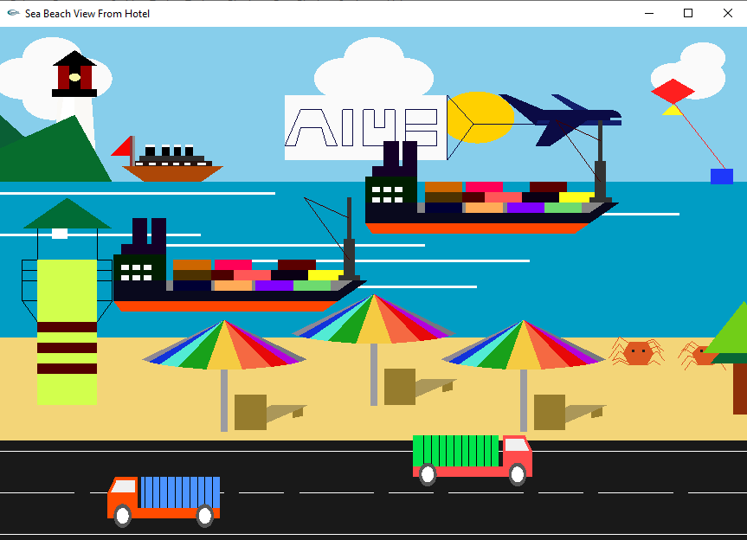
BEACH VIEW: DAY

Slide 5
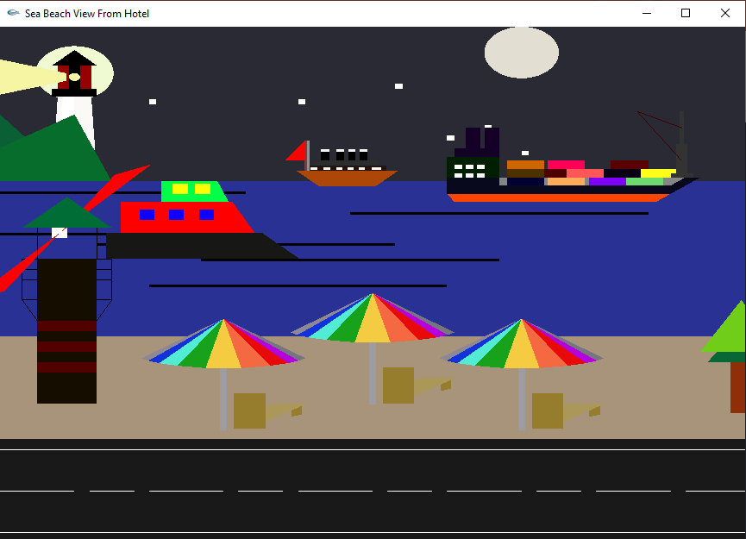
BEACH VIEW: NIGHT

Slide 6
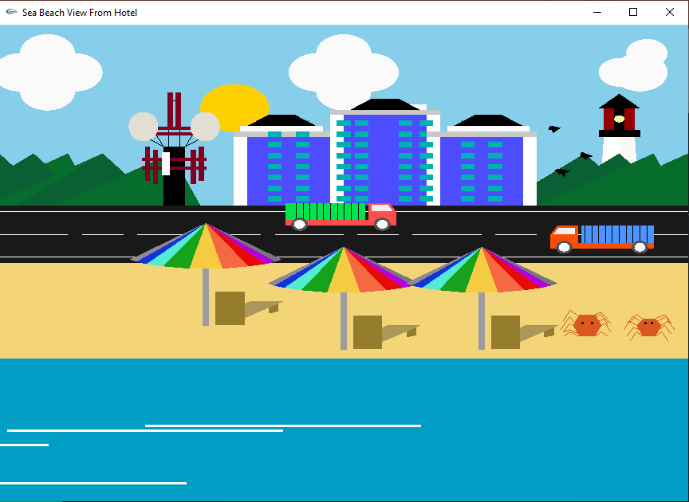
HOTEL VIEW: DAY

Slide 7
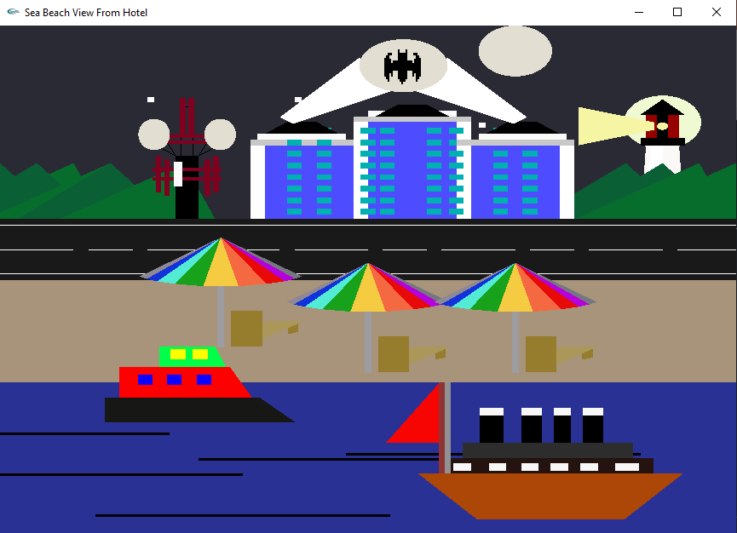
HOTEL VIEW: NIGHT

Slide 8
Thank You

